Slide 1

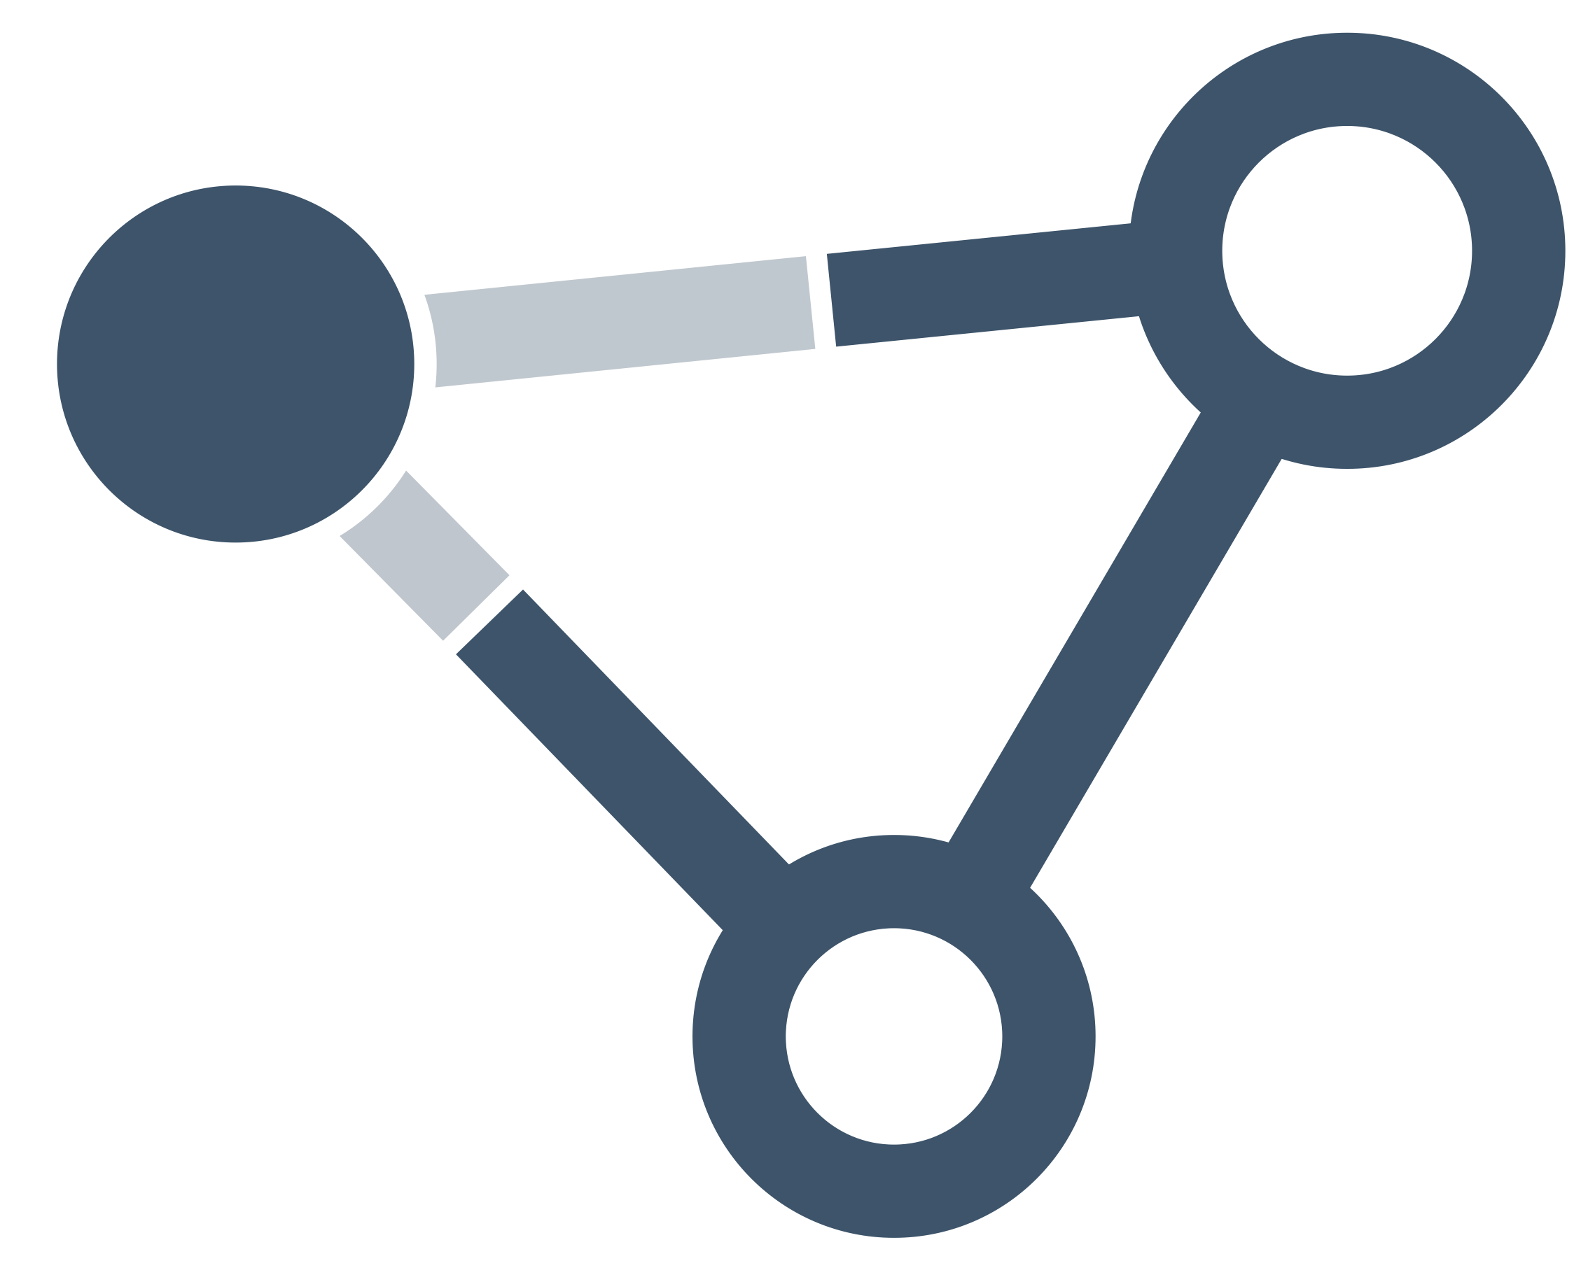




A new dimension to application’s behaviour with Rootz JS
“The strength of JavaScript is that you can do anything. The weakness is that you will“
- Reg Braithwaite
Author: Trishanth Naidu
Follow Rootz JS on…
https://rootzjs.org
npm i @rootzjs/core
github/rootzjs
linkedin.com/rootzjs
@trishanthnaidu

Slide 2

#JsPayPal2021TrishanthNaidu5657

Slide 3
What is Application Behaviour ?
The application’s response to user’s action is known as the application behaviour.
We justify an application’s behaviour to how it responds to the events.
Hover
Click
user’s action
Change
response
Swipe
These events provide a channel for the users to interact with the web application.
Keydown
Keyup
Rootz provides a platform to the developers to derive a logical structure to manage the application’s response efficiently.
Touch
@trishanthnaidu

Slide 4
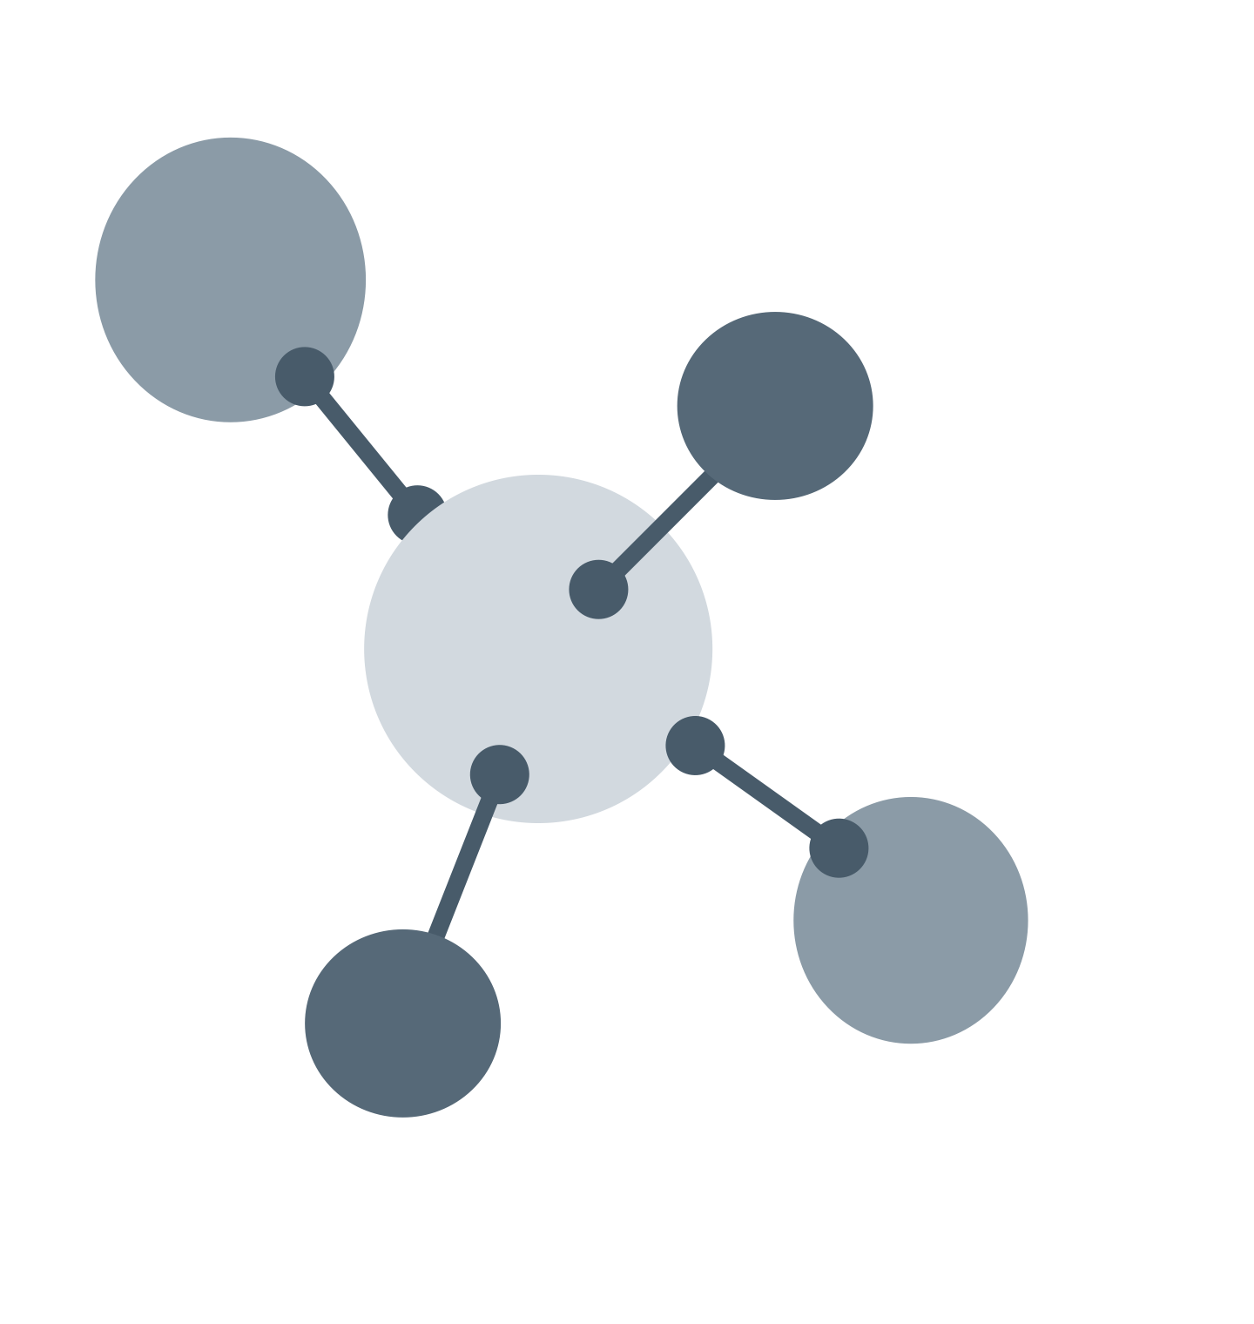
{jsx}
What is Rootz ?
Roots is an open source JavaScript library used for managing application state.
It follows a structural-functional paradigm, which sees your application as a set of Nodes (Not to be confused with Node JS) interconnected through definitive set of actions, defined during the application building process.
Each action defines the change of state of the Node. All the Nodes abide by these actions resulting into expected application’s behaviour.
{jsx}
Nodes
Root
{jsx}
{jsx}
@trishanthnaidu

Slide 5
What does Rootz try to solve ?
Rootz
N2
N1
Nn
Rootz
Rootz provides a definitive structure to your application by decoupling the logical entity (Nodes) from the component making them dumb.
Rootz creates a network of responsible Nodes. A Node takes the responsibility of updating another Node through actions. This resolves the inter-component-state-dependencies.
Rootz distributes the dependencies among Nodes, rather imposing too much dependencies on a single component.
Rootz Devtools provides a complete structural layout of your application. This gives insight about how, when and where your application state changes. Also provides smart tools for Effective code, structural, and behavioural review.
Helps reduce code redundancy. Achieve great Lines Of Code to functionality ratio.
Update Nn (newState)
newState received
Node
{jsx}
{jsx}
{jsx}
Action called (newState)
Rendered with newState
component
@trishanthnaidu

Slide 6
What does Rootz try to solve ?
Rootz provides a definitive structure to your application by decoupling the logical entity (Nodes) from the component making them dumb.
Rootz creates a network of responsible Nodes. A Node takes the responsibility of updating another Node through actions. This resolves the inter-component-state-dependencies.
Rootz distributes the dependencies among Nodes, rather imposing too much dependencies on a single component.
Rootz Devtools provides a complete structural layout of your application. This gives insight about how, when and where your application state changes. Also provides smart tools for Effective code, structural, and behavioural review.
Helps reduce code redundancy. Achieve great Lines Of Code to functionality ratio.
ON_CLICK
ON_CHANGE
ON_MOUNT
@trishanthnaidu

Slide 7
H A N G N
It’s time to get technical
@trishanthnaidu

Slide 8
#JsPayPal2021TrishanthNaidu5657

Slide 9
export default Component = (NodeProps) => {
const { state, actions } = NodeProps;
return (
<button onClick={ }>
{ }
</button>
)
};
Component
import { createNode } from "@rootzjs/core";
const [node, dispatchNode] = createNode(”Node1", Component);
node.state({ });
node.useAction( , {
});
export default dispatchNode(node);
Node
actions.ON_BTN_CLICK
text: "Click to update state"
state.text
"ON_BTN_CLICK"
text: "Yay! It's that simple"
Reference of state and actions are passed as parameters
Rootz will update the state of the Component mapped to the Node with id “Node1”
state and action definition is updated in Root
Output
appRoot = {
Node1: {
state: {
},
actions: {
},
},
};
Rootz (Just for representation what happens within)
Updated state value
Default state
text: ”Yay! It’s that simple",
text: "Click to update state",
Yay! It's that simple
Click to update state
ON_BTN_CLICK: function (newState) {
// logic to update state
},
Event raised
@trishanthnaidu

Slide 10
Too Much Tech ?
That’s something just 1% of what went behind to make this Product.
@trishanthnaidu

